Slide 1
Introduction to Predictive Analytics
Dave Eargle – CU Boulder

Slide 2
Terminology
Model
A simplified representation of reality crated to serve a purpose
Predictive Model
A formula for estimating the unknown value of interest: the target
The formula can be mathematical, logical statement (e.g., rule), etc.
Prediction
Estimate an unknown value (i.e. the target)
Instance / example:
Represents a fact or a data point
Described by a set of attributes (fields, columns, variables, or features)
Model induction:
The creation of models from data
Training data:
The input data for the induction algorithm

Slide 3
Subclasses of Supervised Data Mining
Classification
Categorical target
Often binary
Includes “class probability estimation”
Regression
Numeric target

Slide 4
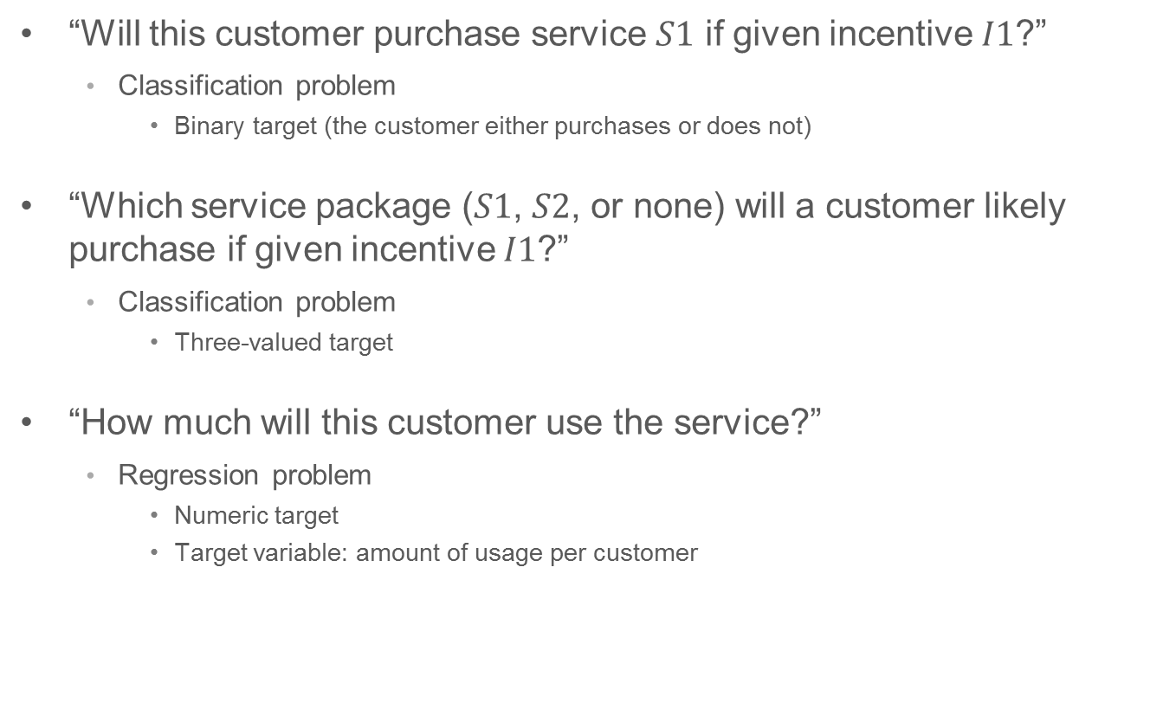
Subclasses of Supervised Data Mining
“Will this customer purchase service $S1$ if given incentive $I1$?”
Classification problem
Binary target (the customer either purchases or does not)
“Which service package ($S1$, $S2$, or none) will a customer likely purchase if given incentive $I1$?”
Classification problem
Three-valued target
“How much will this customer use the service?”
Regression problem
Numeric target
Target variable: amount of usage per customer

Slide 5

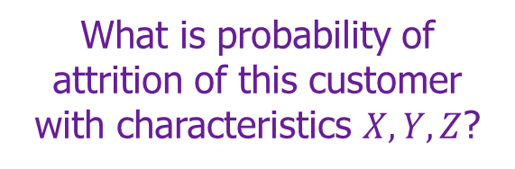
Data Mining Model in Use
What is probability of attrition of this customer with characteristics $X, Y, Z$?
$$p(C|X,Y,Z) = 0.85$$

Slide 6
Data Mining versus Use of the Model
“Supervised” modeling:
“Training” data have all
values specified
Model in use:
New data item has some value unknown (e.g., will she leave?)

Slide 7
Let’s do it!
Download demographic_data_orig.csv
Let’s predict the amount of the sale
What kind of data type is that target variable? Continuous
So we’ll use Linear Regression
Take a random sample of 2k rows, because otherwise the modeling takes a long time
Set “region” to be a string-type
Do an Association Analysis,
compare amount and age
compare amount and item
which is a good candidate for a model?
Do a “Plot of Means”
compare Region and amount
is it a good candidate for a predictive model?
Linear Regression, add all `Browses`
investigate the Interactive report
“Score” it

Slide 8
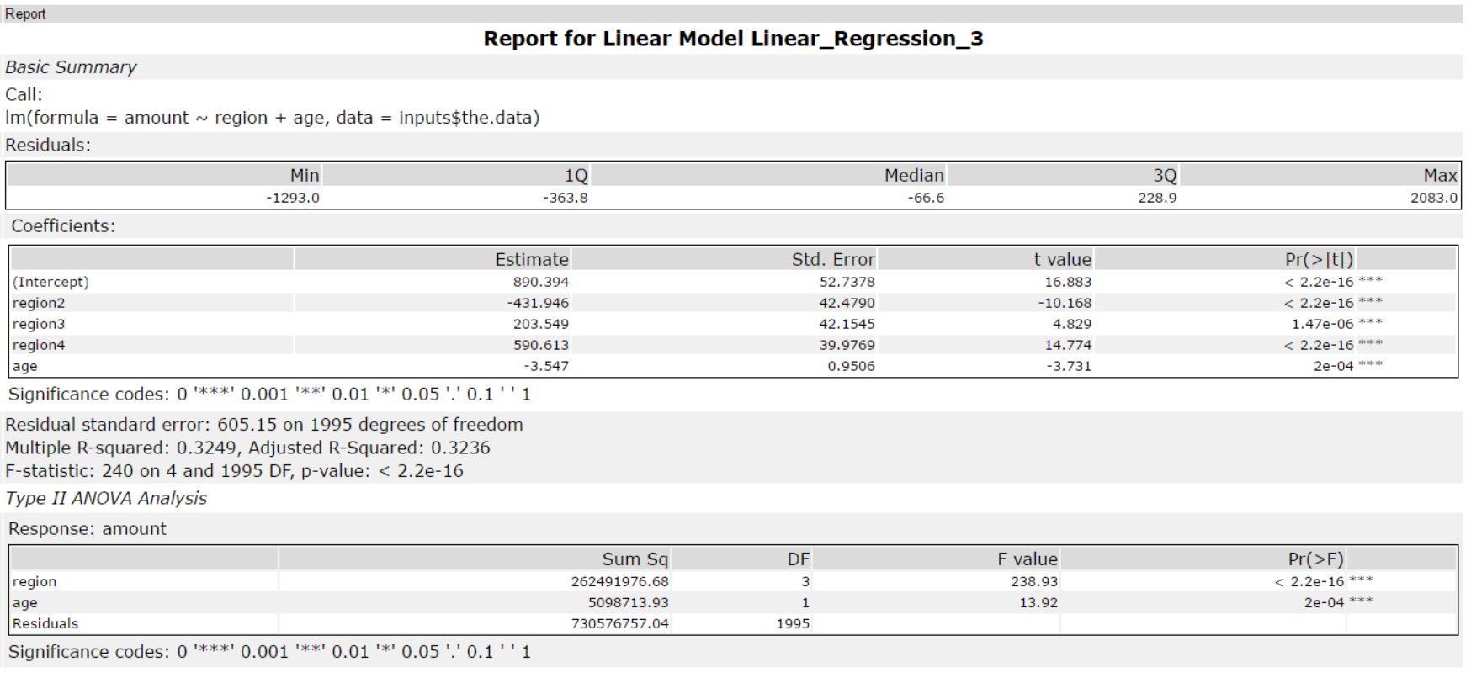
How to interpret?

Slide 9
How to interpret?
`Amount` is predicted by a combination of `region` and `age`

Slide 10
How to interpret?
These are beta estimates (B), or weights. To calculate a prediction, you just use these numbers
If your model only had `age` in it (this one has more than just `age`), you would make a prediction like this: amount = intercept + B_age * x_age if someone were 40 years old,
amount = 890 + -3.547*(40)
amount = 748.12

Slide 11
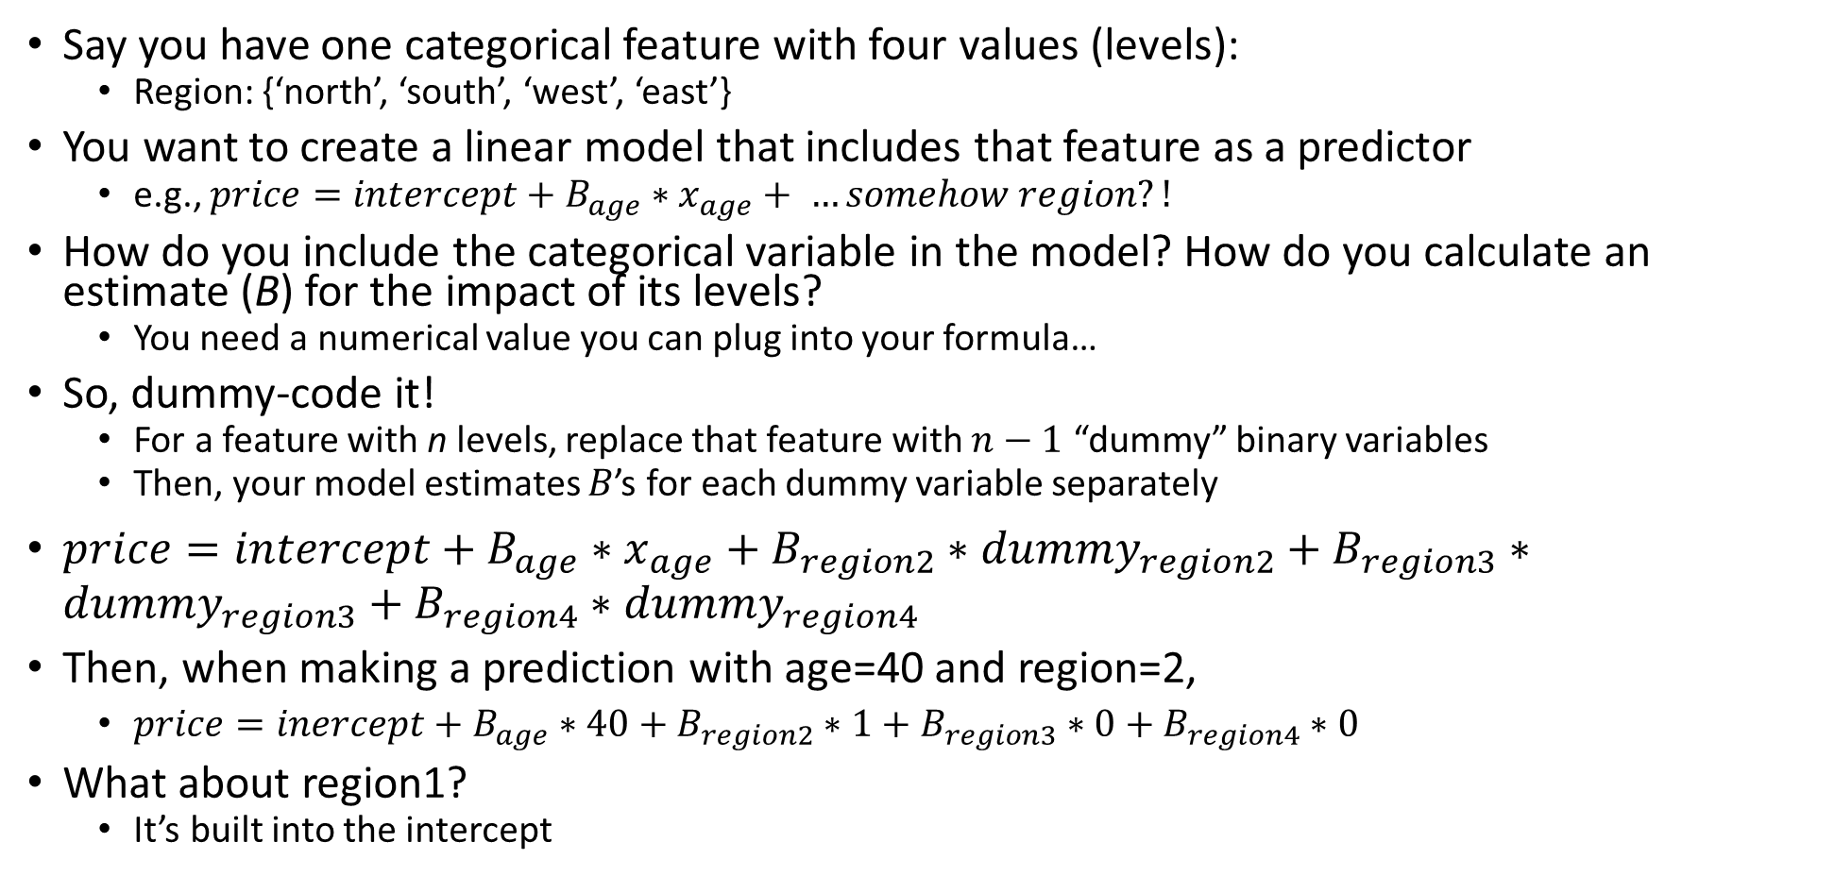
Dummy-Coding
Say you have one categorical feature with four values (levels):
Region: {‘north’, ‘south’, ‘west’, ‘east’}
You want to create a linear model that includes that feature as a predictor
e.g., $price=intercept+B_{age}∗x_{age}+ …somehow region?!$
How do you include the categorical variable in the model? How do you calculate an estimate (B) for the impact of its levels?
You need a numerical value you can plug into your formula…
So, dummy-code it!
For a feature with n levels, replace that feature with $n−1$ “dummy” binary variables
Then, your model estimates $B$’s for each dummy variable separately
$price=intercept+B_{age}∗x_{age}+B_{region2}∗dummy_{region2}+B_{region3}∗dummy_{region3}+B_{region4}∗dummy_{region4}$
Then, when making a prediction with age=40 and region=2,
$price=inercept+B_{age}∗40+B_{region2}∗1+B_{region3}∗0+B_{region4}∗0$
What about region1?
It’s built into the intercept

Slide 12
How to interpret?
These are beta estimates (B), or weights. To calculate a prediction, you just use these numbers
Region has been “dummy-coded” –one feature with 4 different values have been replaced with 3 features that are only ever 0 or 1.
To make a prediction,
amount = intercept + B`age` * age + B`region2` * region2 + B`region3` * region3 + B`region4` * region4
For example, for someone in region 2 who is 50:
amount = 890.394 + -3.547*50 + (-431.946)*1 + 203.549*0 + 590.613*0
amount = 281.098

Slide 13
How to interpret?
These tell you how “good” the model is. E.g., how close are the predicted values to the actual values?
More on this later.

Slide 14
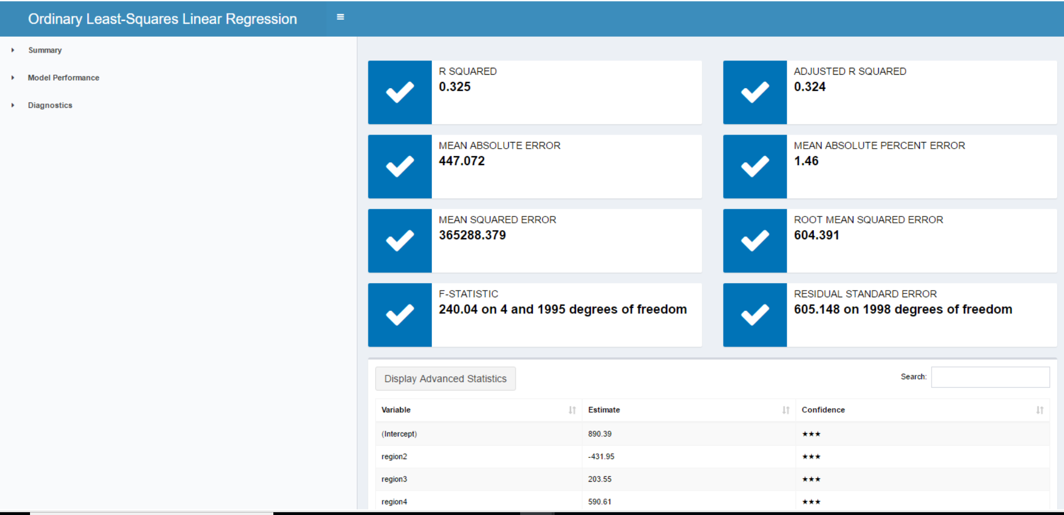
All of this is also available in the “interactive” report for a Linear Regression

Slide 15
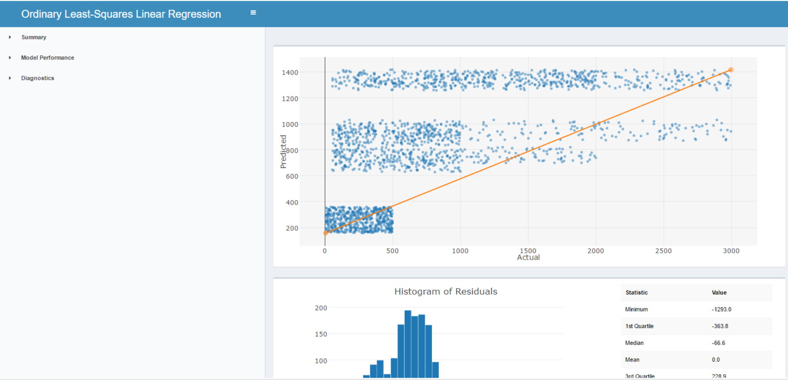

Slide 16
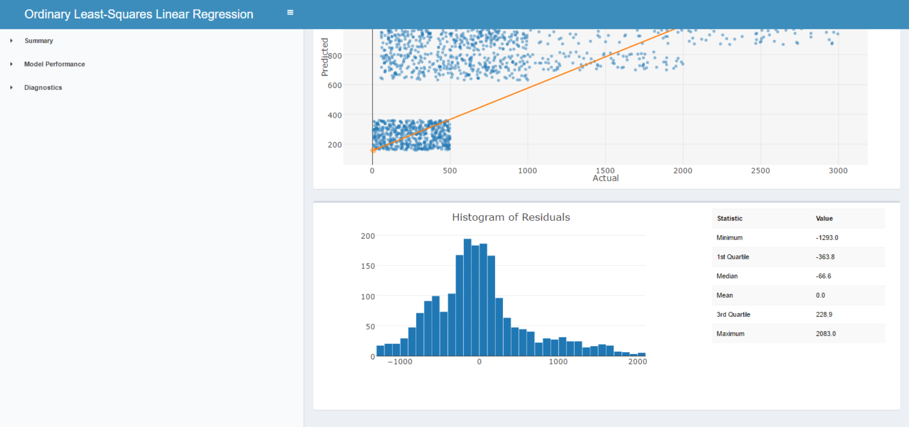

Slide 17
If extra time
Download luxury_shoes_trimmed.csv
We’re going to predict the maximum price at which a shoe has ever been listed
What kind of data type is that target variable? Continuous
So we’ll use Linear Regression
Filter to just records that have a `rating` -- should result in ~2k rows
`Select` just `rating`, `brand`, `price.amountMax`, `price.amountMin`
Do an Association Analysis
Linear Regression, add all `Browses`
investigate the Interactive report

Slide 18
Many figures in this slide deck from Provost, F., & Fawcett, T. (2013). Data science for business: what you need to know about data mining and data-analytic thinking. Sebastopol, Calif.: O'Reilly.

